Slide 1
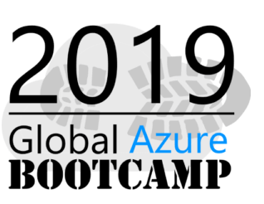





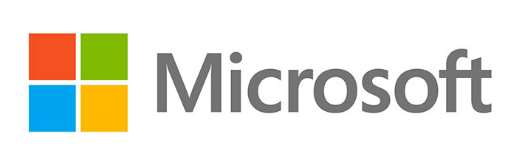


Sponsors for Azure Bootcamp

Slide 2
Getting Started with Machine Learning using Spark in Azure HDInsight
Ingyu Lee
Troy University
https://github.com/Azure-Bootcamp-Troy/SparkOnHDInsight

Slide 3
Content
What is Spark on HDInsight?
Demo: Create Spark Cluster on Azure
What is an RDD, DataFrames, Spark SQL?
Demo: Operations of RDD, DataFrames and SQL
What is MLlib?
Demo: Machine Learning using Spark
For Whom this talk
Business users to analyze Big Data using Spark on Azure Cluster.
Prerequisite
None

Slide 4
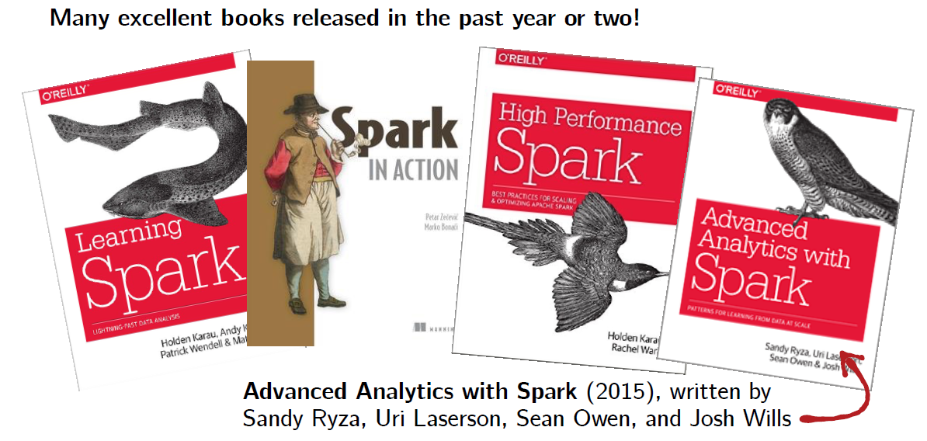
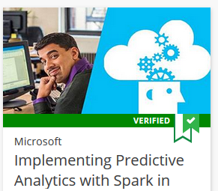
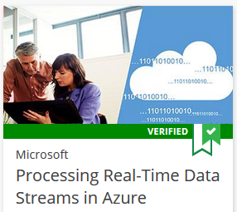
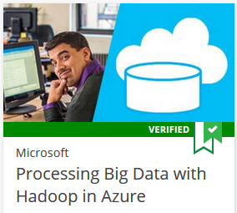

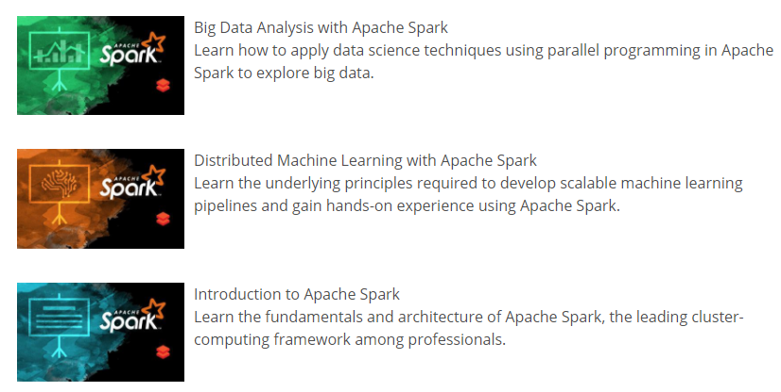
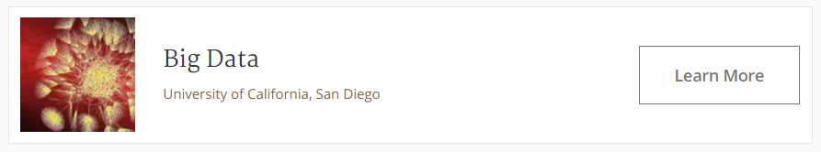
References
This talk is based on this course

Slide 5
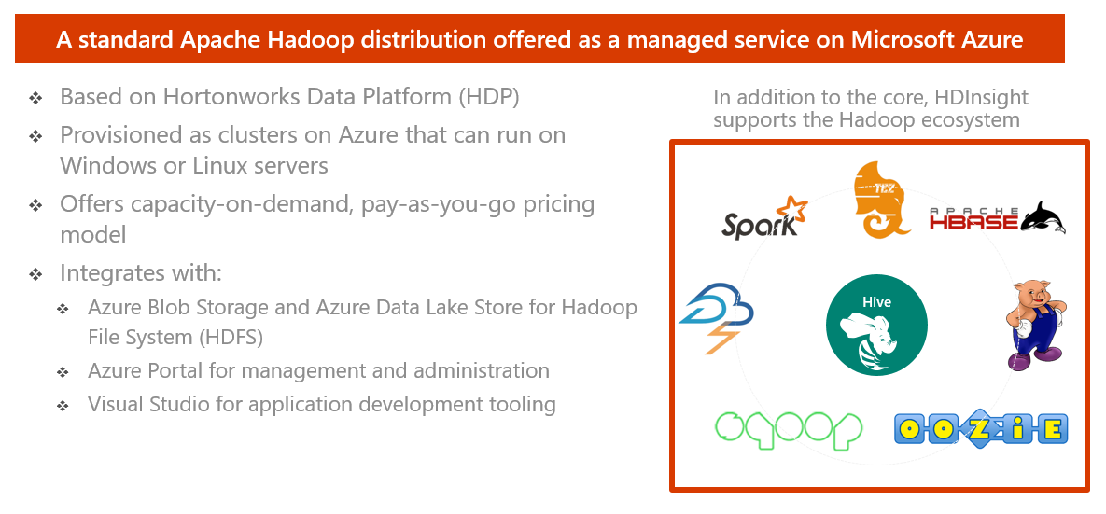
HDInsight – What is it?

Slide 6
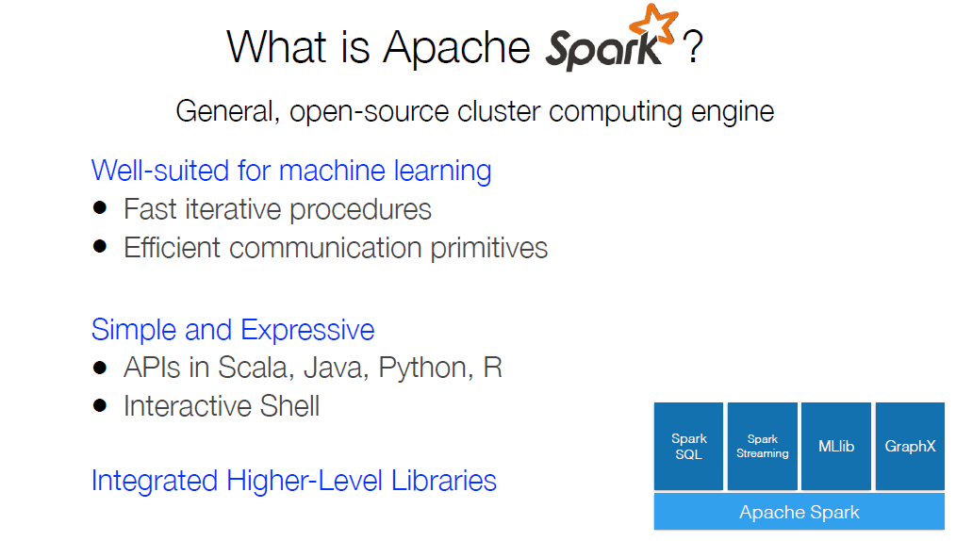
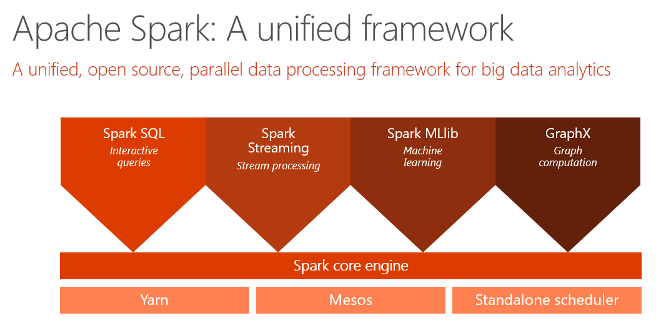

Slide 7
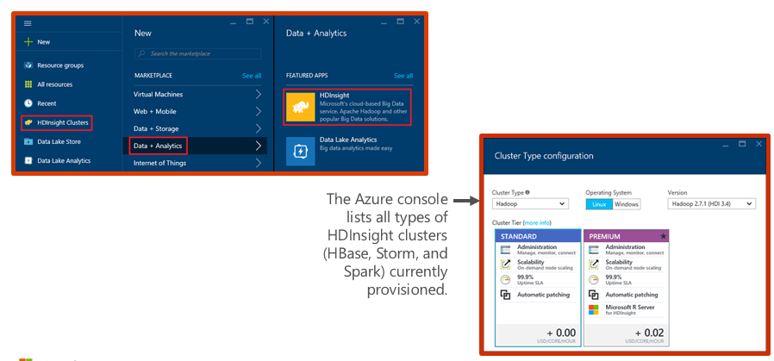
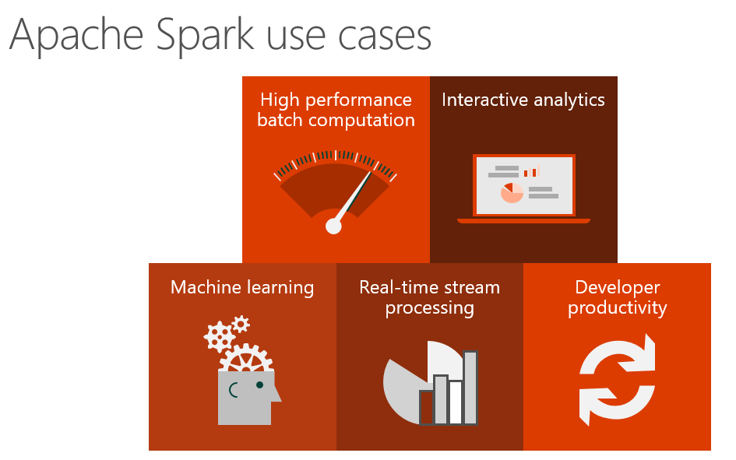
Demo: Creating an HDInsight Spark cluster

Slide 8
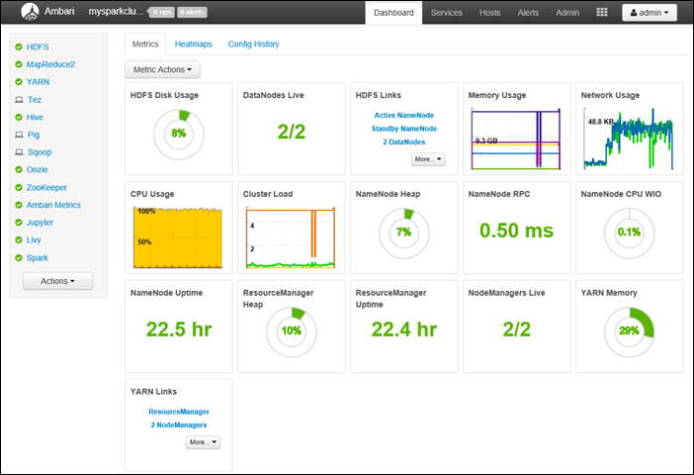
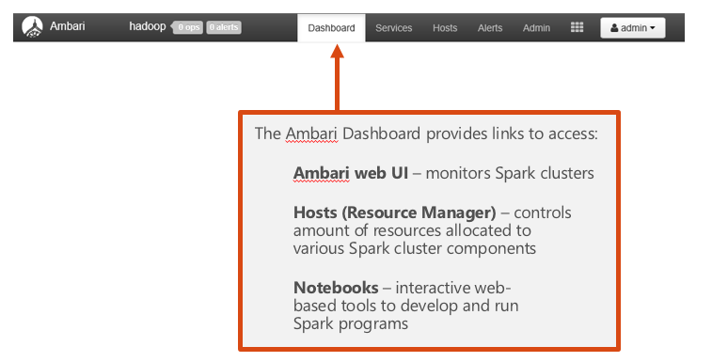
Demo: Ambari Dashboard

Slide 9
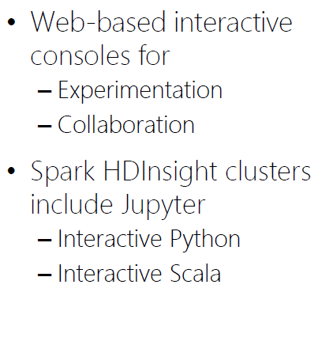
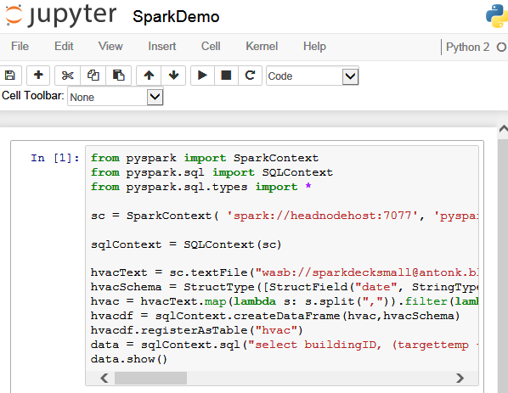
Demo: Jupyter notebooks

Slide 10
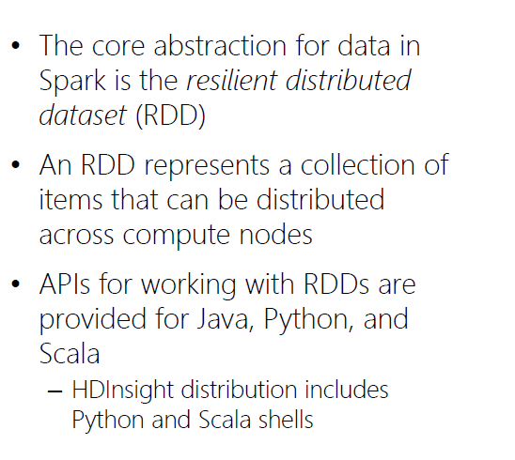
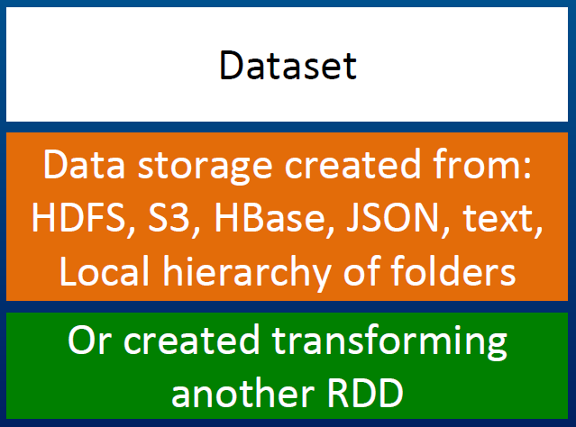
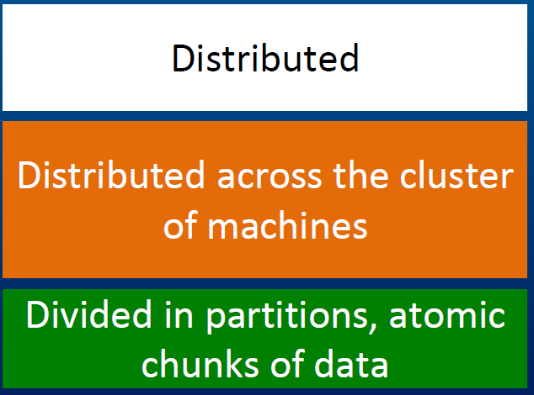
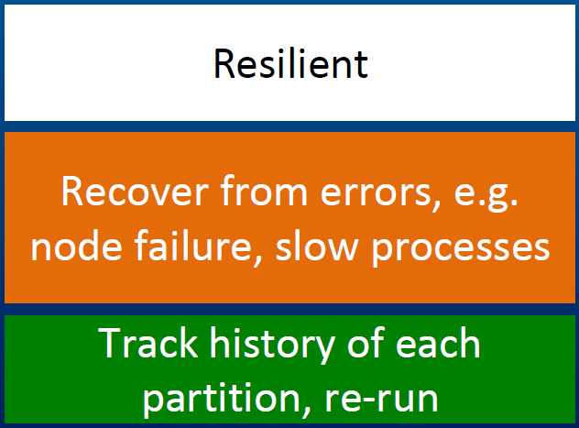
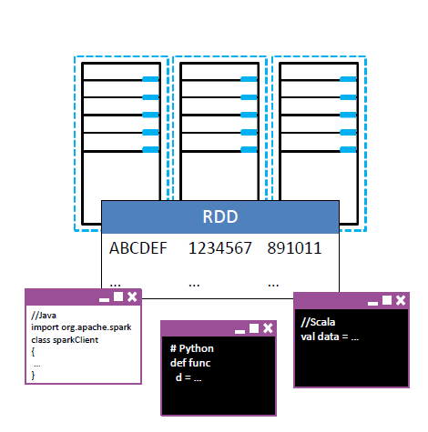
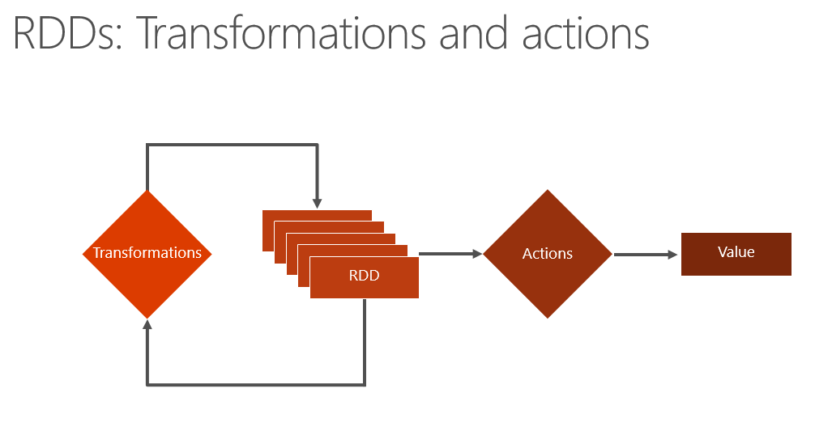
What is RDD?

Slide 11
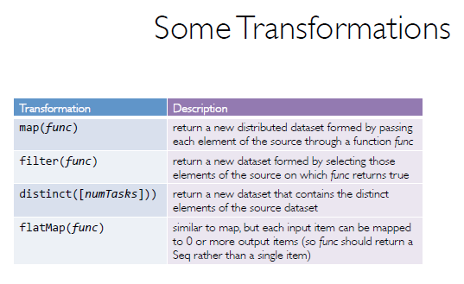
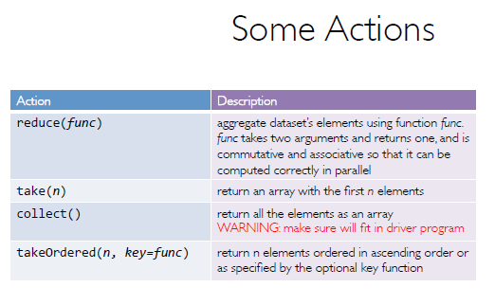
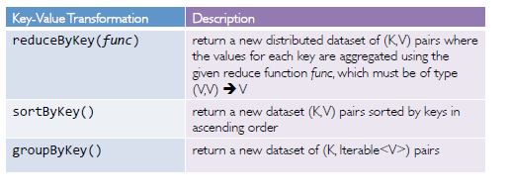
RDD Operations

Slide 12
What is DataFrames?
A distributed collection of data organized into named columns.
Similar to RDDs with schema.
Conceptually equivalent to tables in relational database, or to DataFrames in R/Python.
With domain-specific functions designed for common tasks:
Metadata
Sampling
Project, filter, aggregation, and join
UDFs
RDDs are a collection of opaque objects (such as internal structures unknown to Spark).
User
User
User
User
User
User
DataFrames is a collection of objects with schema that are known to Spark SQL..
Name
Age
Sex
Name
Age
Sex
Name
Age
Sex
Name
Age
Sex

Slide 13
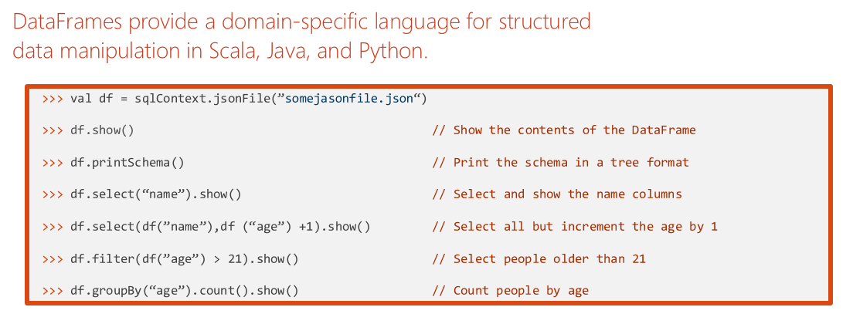
DataFrame Operations

Slide 14
What is Spark SQL?
Create an Azure storage account
HDInsight makes Apache Spark available as a service in cloud.
Run Spark SQL statements using notebooks
1
2
3
HDInsight uses Azure Blob storage account for storing data.
HDInsight makes Apache Spark available as a service in cloud.
You run interactive Spark SQL statements using notebooks.

Slide 15
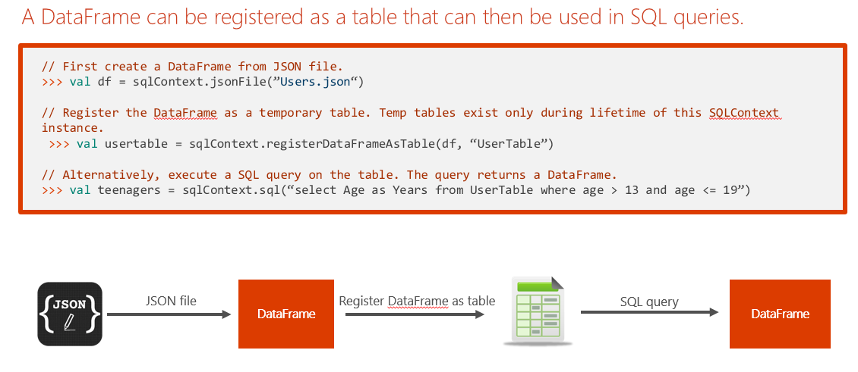
Tables and Queries

Slide 16
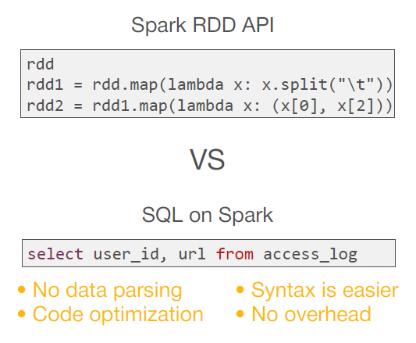
Spark SQL Operations

Slide 17
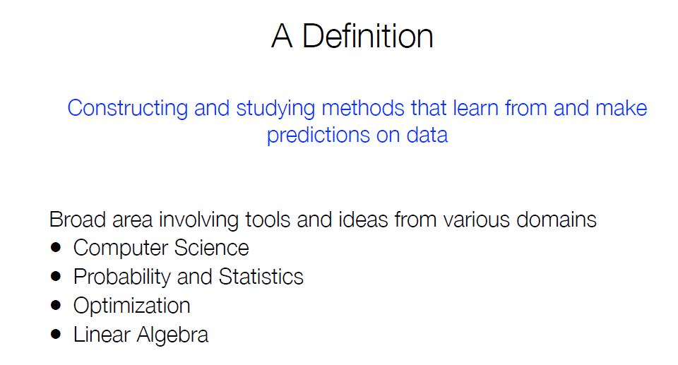
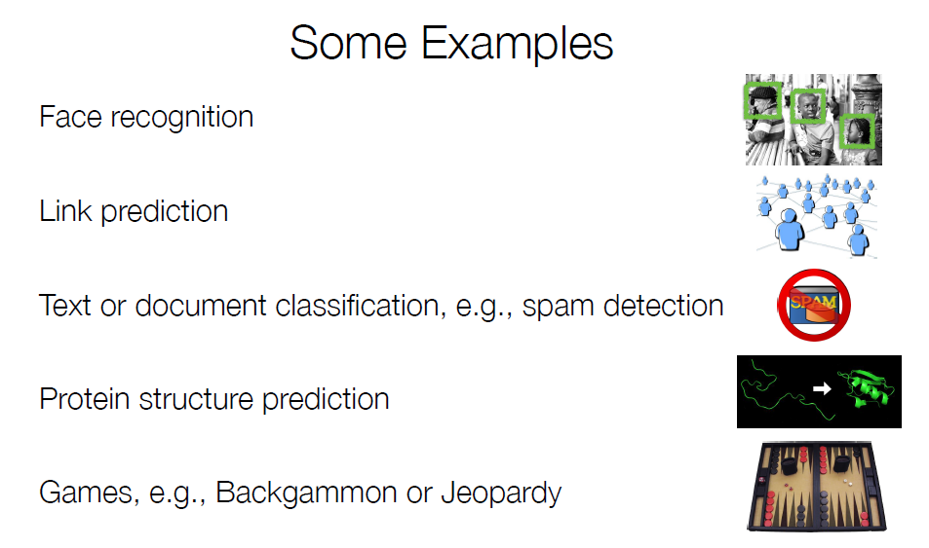
What is Machine Learning?

Slide 18
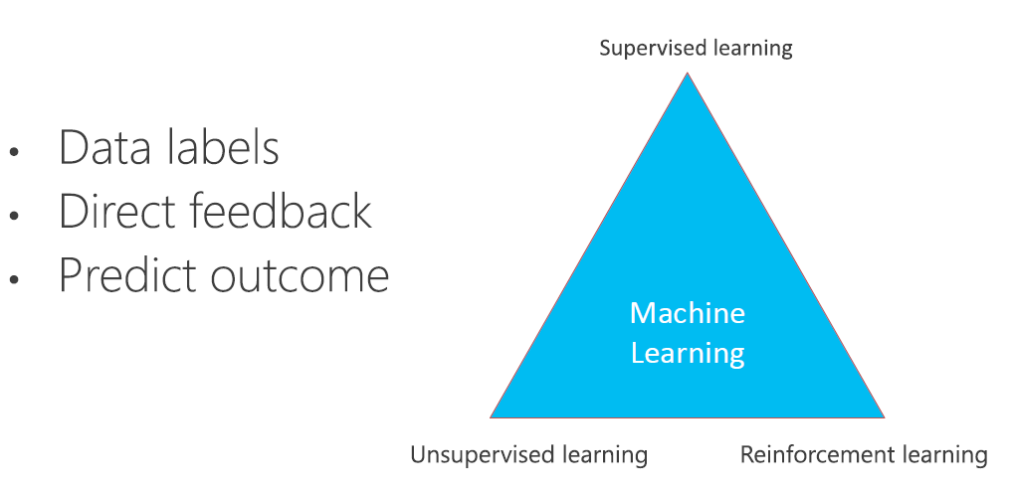
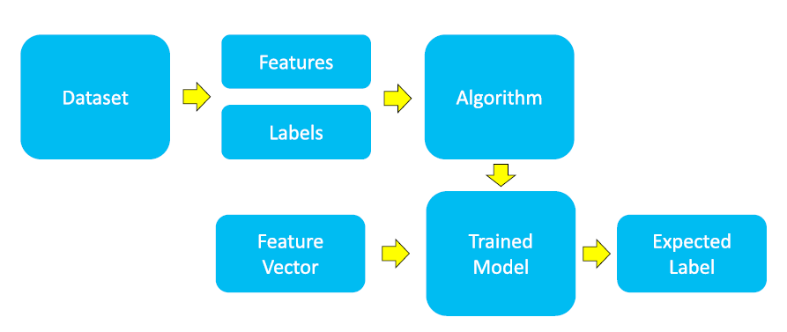
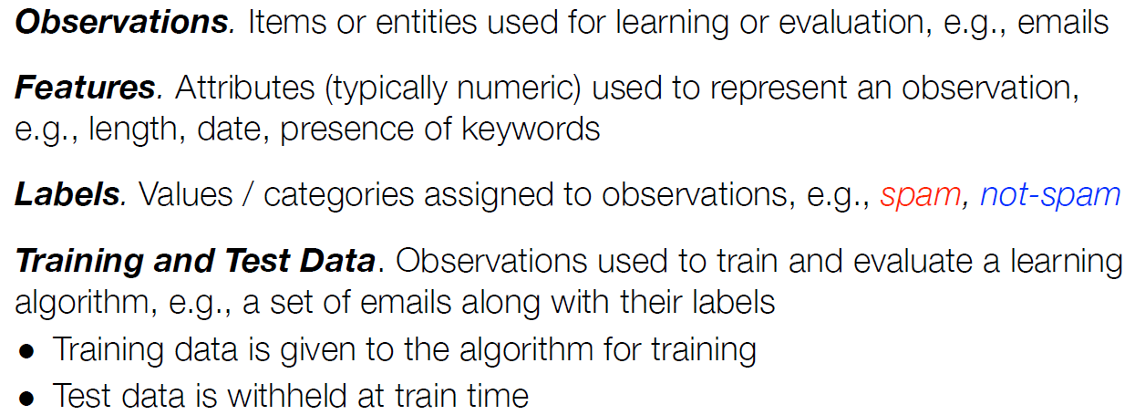
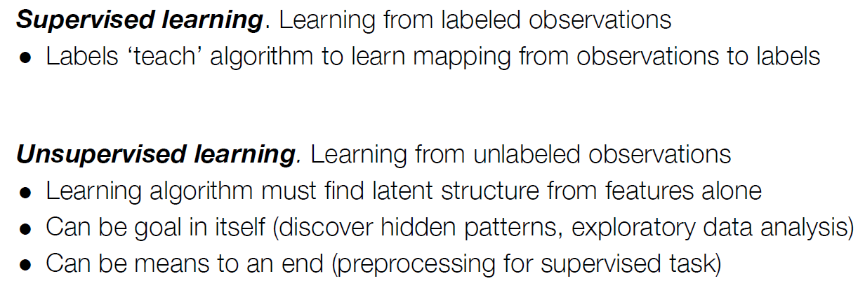
How does Machine Learning work?

Slide 19
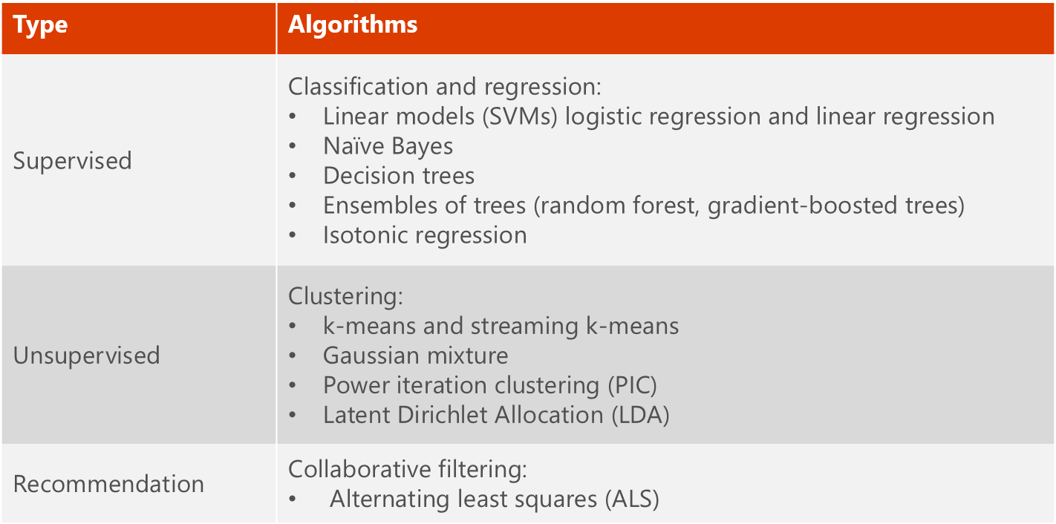
What is MLlib?
MLlib is a collection of machine learning algorithms optimized to run in a parallel, distributed manner on Spark clusters.
MLlib helps lead to better performance on large data sets.
MLlib integrates seamlessly with other Spark components.
MLlib applications are developed in Java, Scala, and Python.

Slide 20
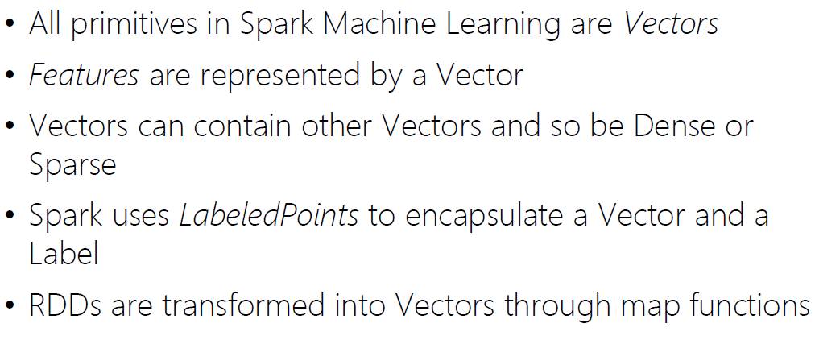
How to.. Machine Learning in Apache Spark?

Slide 21
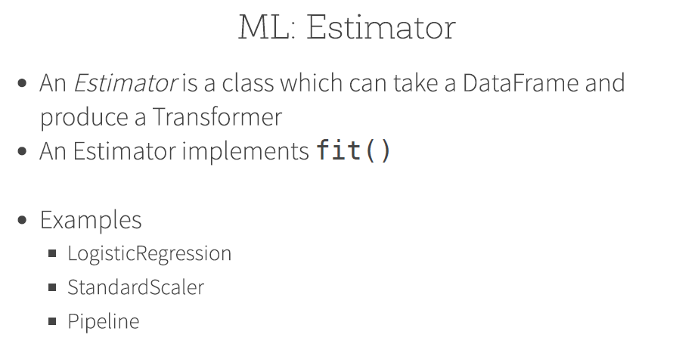
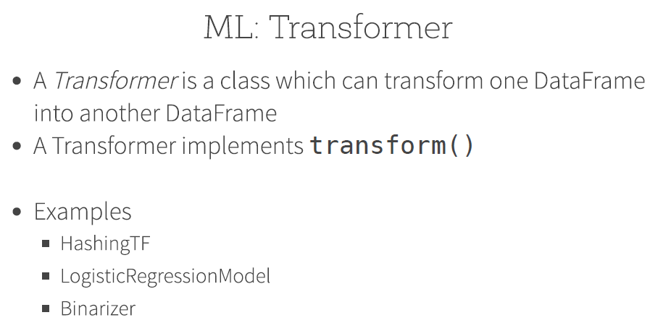
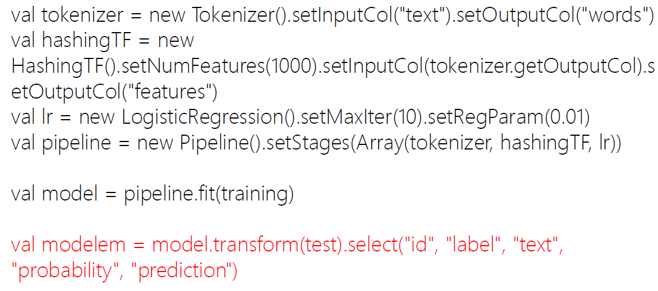
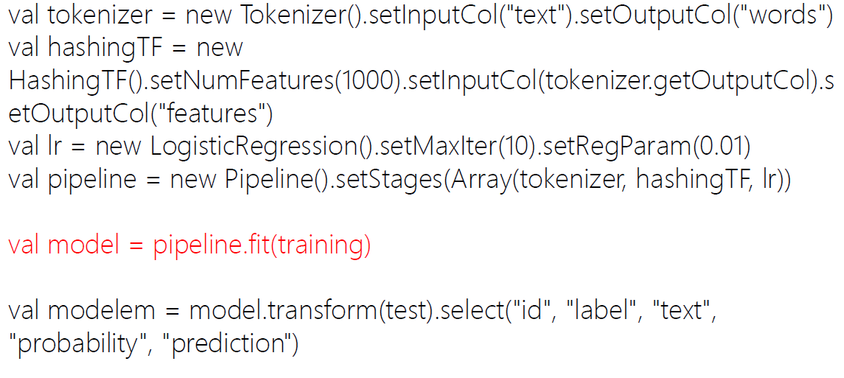
MLlib Terminology

Slide 22
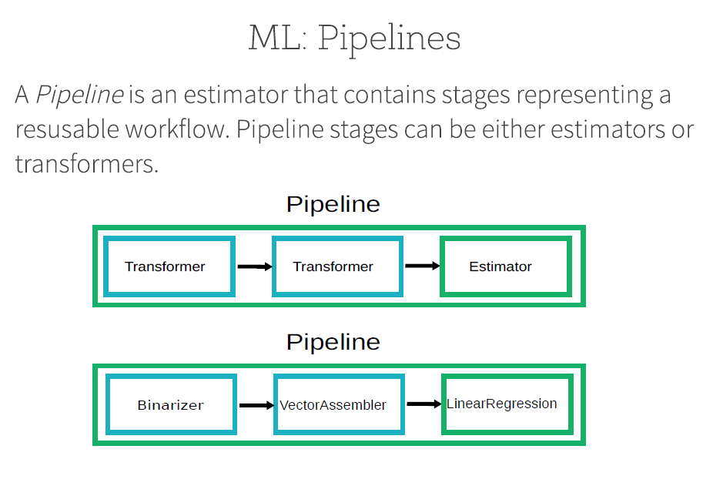
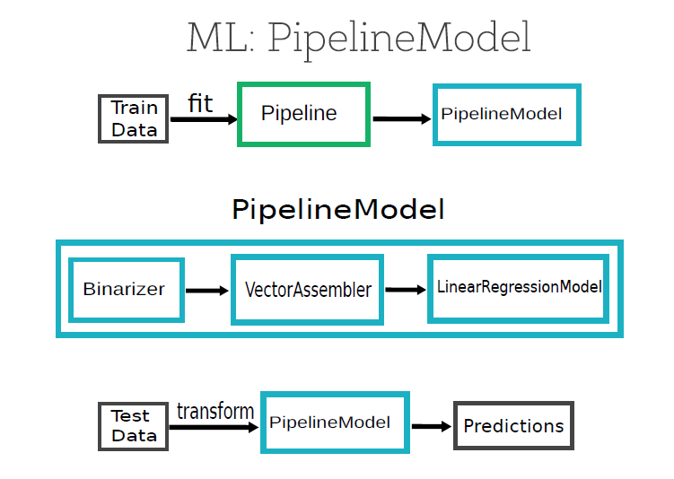
MLlib Terminology

Slide 23
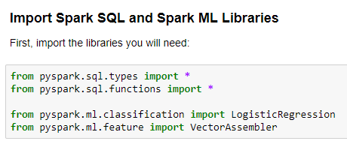
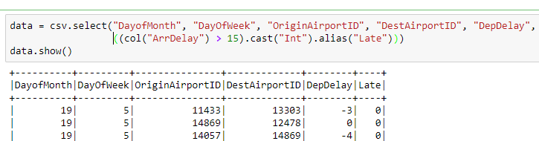
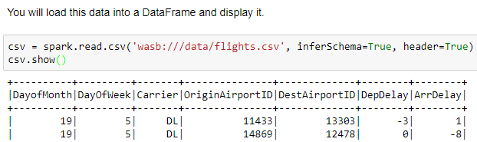
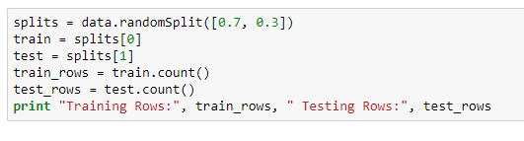
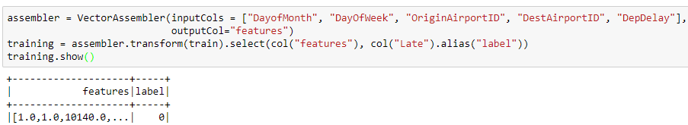
Examples: Classification
Prepare the Data
Split the Data
Load Source Data
Prepare the Training Data

Slide 24
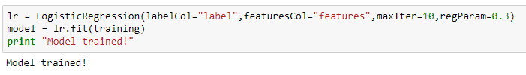
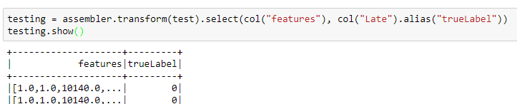

Examples: Classification
Train a Classification Model
Prepare the Testing Data
Test the Model

Slide 25





Example: Regression
Prepare the Data
Split the Data
Load Source Data
Prepare the Training Data

Slide 26



Example: Regression
Train a Regression Model
Prepare the Testing Data
Test the Model

Slide 27



Example: Pipeline
Define the Pipeline
Run the Pipeline as an Estimator
Test the Pipeline Model

Slide 28



More Example: Text Analysis
Test the Pipeline Model
Run the Pipeline as an Estimator

Slide 29



More Example: Clustering
Create the K-Means Model
Get the Cluster Centers
Predict Clusters

Slide 30





More Example: Recommendation

Slide 31

Questions

